Slide 1
Telco Customer Churn Prediction using Logistic Regression
Ramandeep Singh
21901014

Slide 2
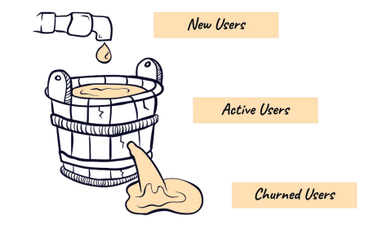
Introduction
Customer churn is the situation where clients stop doing business with a business and stop using its goods or services. Customer churn specifically refers to subscribers who break their contracts for mobile phone or internet service in the context of telecom businesses.
Customer churn prediction is the process of identifying customers who are at risk of churning and taking actions to retain them. It can help businesses to reduce customer acquisition costs, increase customer lifetime value, and improve customer satisfaction and loyalty.

Slide 3
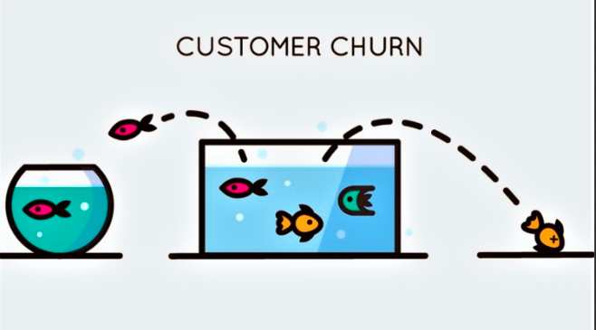
Impact of Customer Churn on Telco business
Customer churn has a significant impact on telco companies. Here are a few key effects:
Revenue Loss
Decreased Market Share
Increased Customer Acquisition Costs
Reputation Damage
Reduced Customer Lifetime Value

Slide 4
Why Telco Customer Churn Matters
Telco industry is highly competitive, and customer acquisition costs are substantial.
Customer churn has a direct impact on revenue and profitability.
By reducing customer churn, telco companies can improve customer lifetime value and enhance business growth.

Slide 5
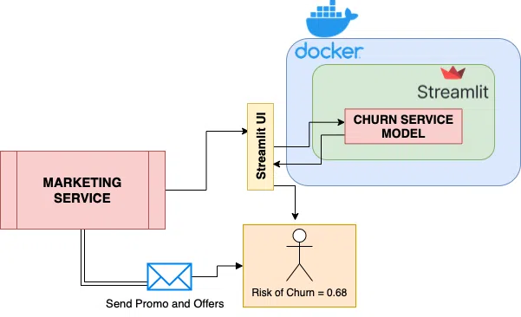
Objectives of the Project
There are few objectives that need to be achieved in this project:
Predict churn
Identify at-risk customers
Take proactive measures
Provide real-time predictions
Evaluate model performance
Reduce churn rate

Slide 6
Churn Prediction Process

Slide 7
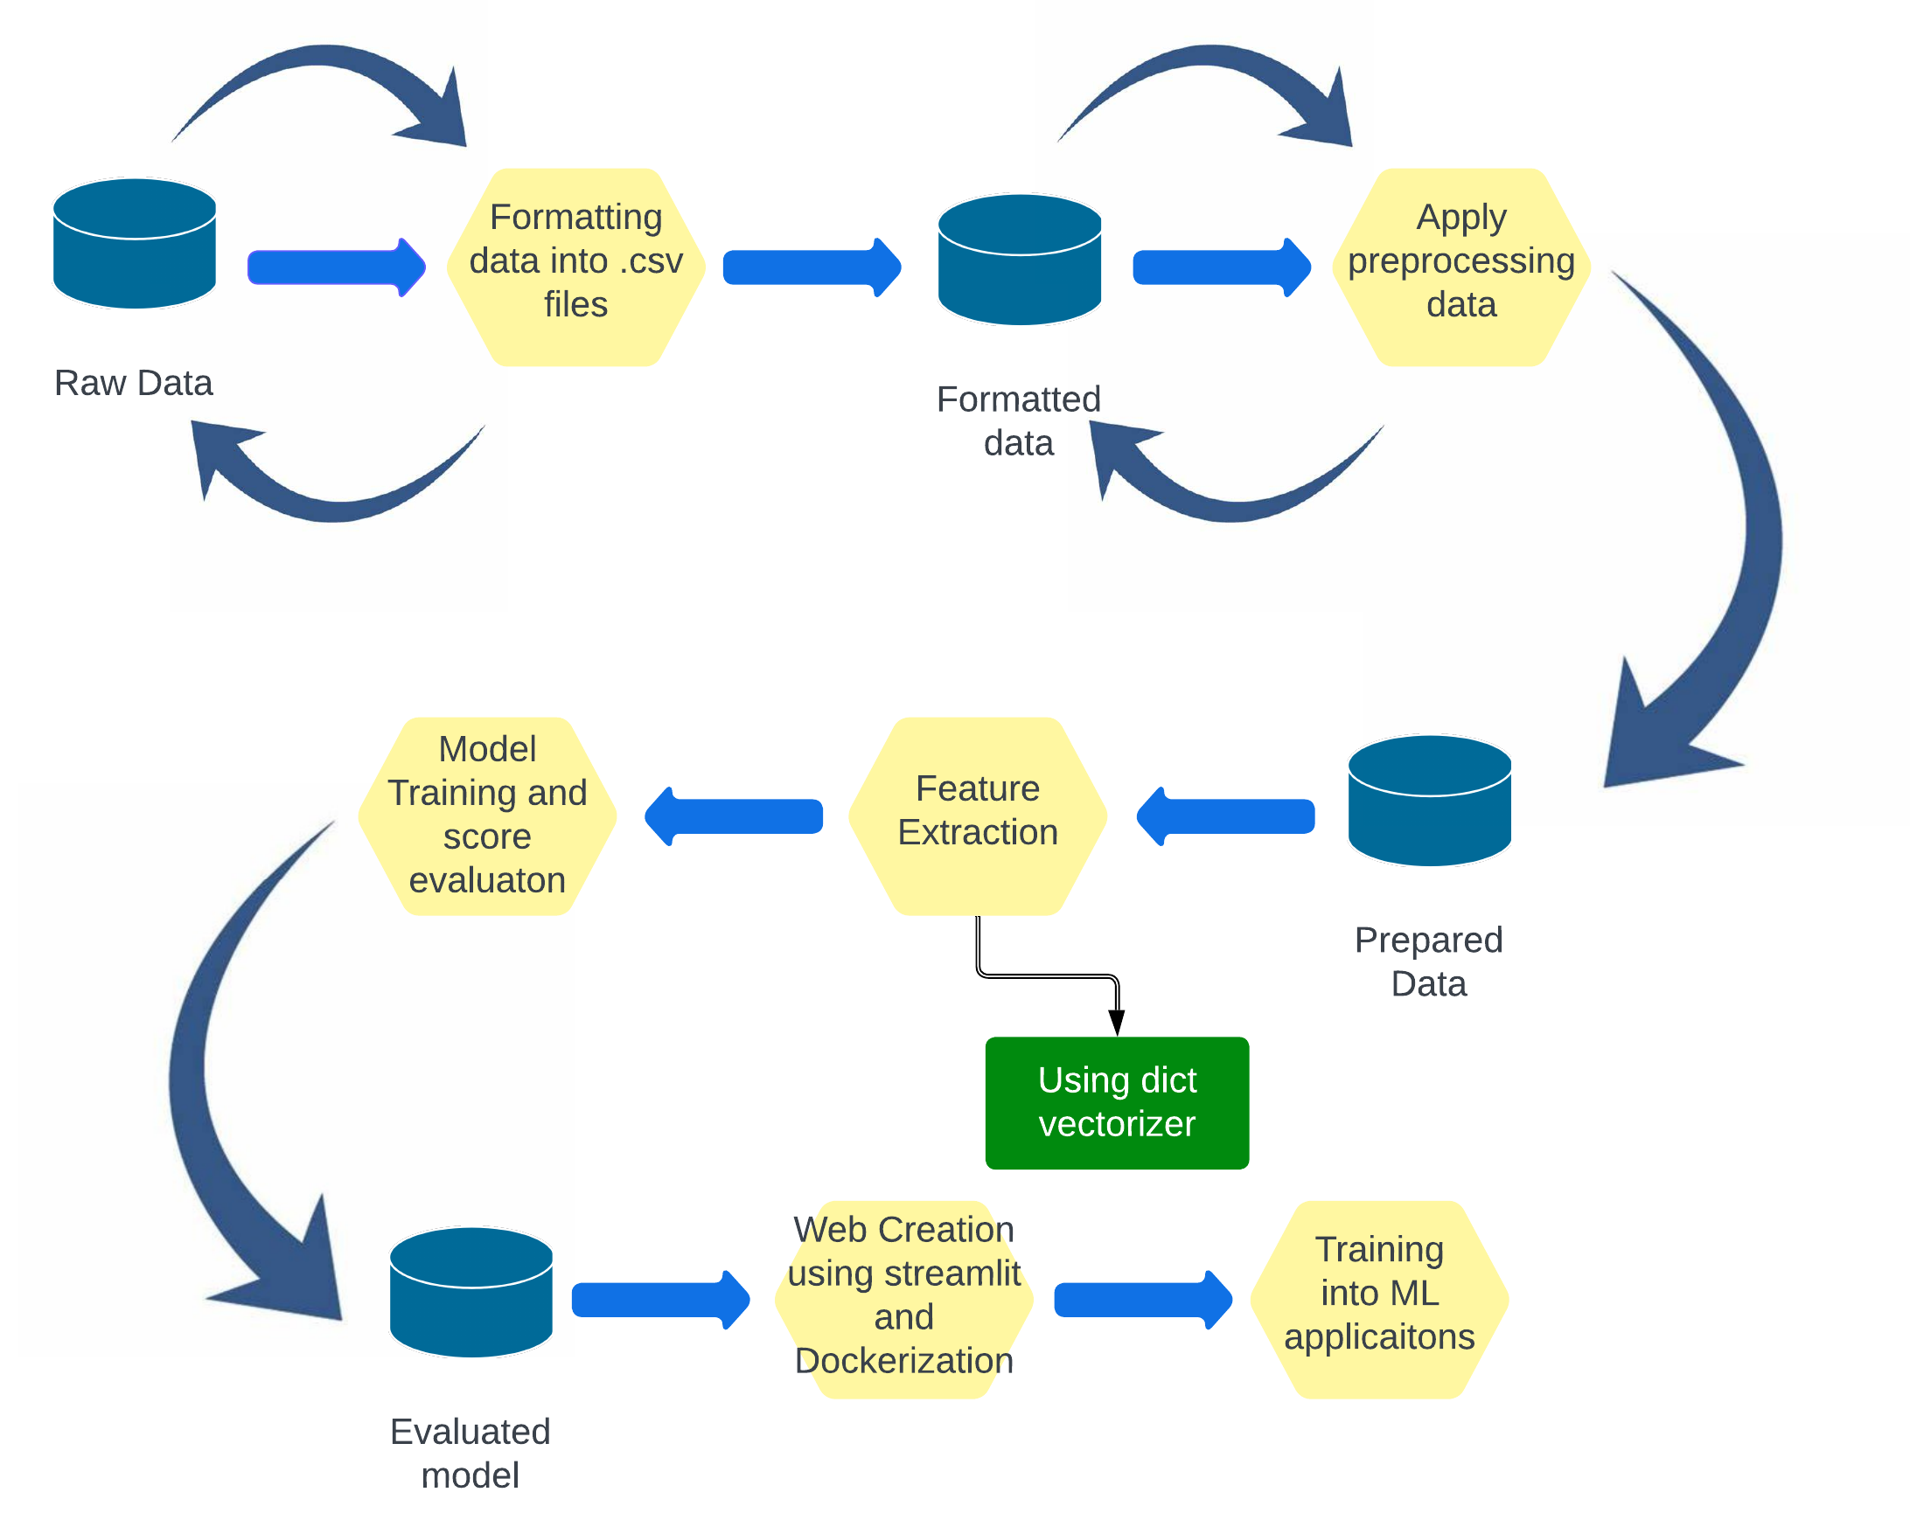
Process Flow

Slide 8
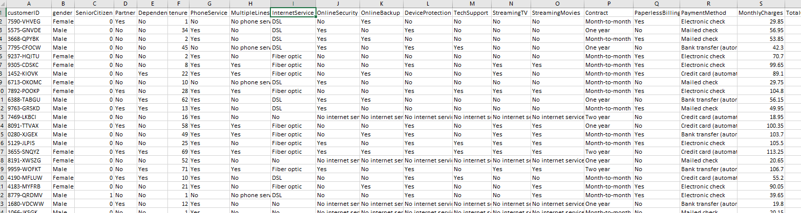
Step 1- Data Collection
We collected a comprehensive dataset that includes customer information, usage patterns, transaction history, and demographic data.
The dataset that We’ve used in this project is the real existing data that can be downloaded from machine learning data repository site. In this project we use Kaggle as a data source.
These dataset might contain more than 5000 labelled messages for training and testing.
Sample data

Slide 9
Initial Data Preparation
In this Step cleaning and preparation of data for the further steps is done .
In this step features of the data and the data types of the features are examined and
converted to the proper format for easy processing and data is splitted into two sets for training and testing purpose.

Slide 10
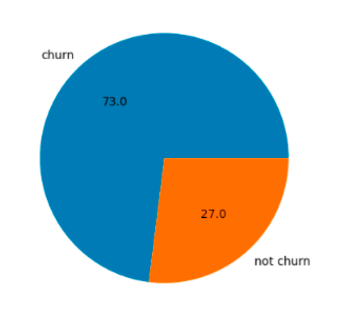
EDA( Explaratory Data Analysis)
In this phase many type of operations and are performed on the data to find the hidden insights in the data several plots are also plotted.
For example, in this pie chart ratio percentage of churn and non churn values is plotted in which it tells the imblanced data set.

Slide 11
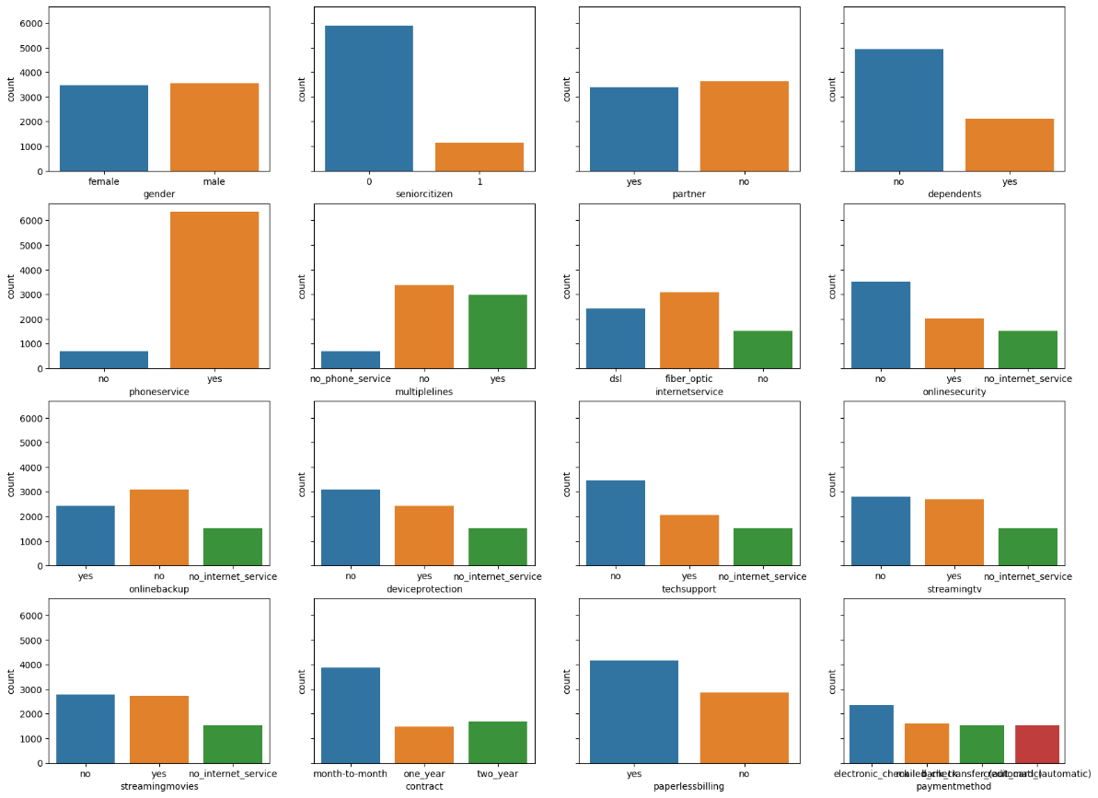
Feature Selection/Importance
In this phase importance of every feature on the result variable is measured and analyzed.
several column wise count and distribution plots are plotted to analyze the importance of each feature on churn feature.
Count plot for every column

Slide 12
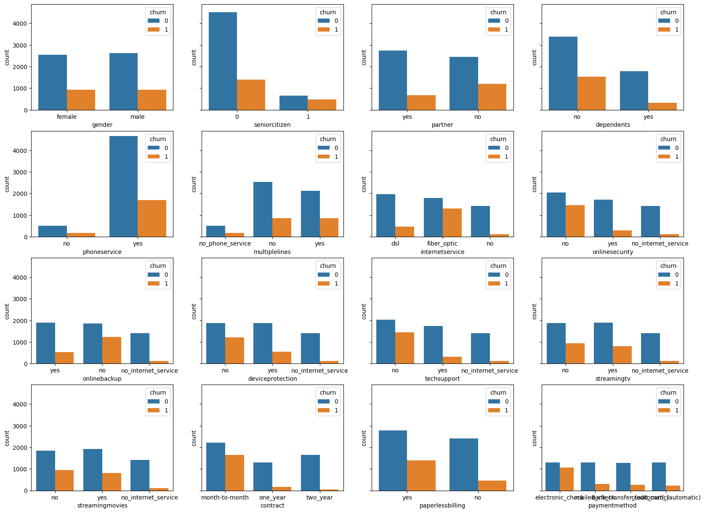
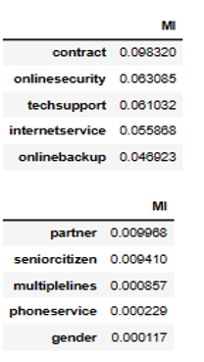
Feature Importance
List of importance list of features on the target variable.
Distrubution of churn among the data

Slide 13
Model Selection
Choosing the right predictive model is essential for accurate churn prediction.
Popular machine learning algorithms for churn prediction include logistic regression, decision trees, random forests, and support vector machines.
Each algorithm has its advantages and considerations, and the choice depends on the specific requirements of the telco company.
For this project Logistic regression is trained using the labeled churn data.
The model learns the relationship between the input features and the churn outcome.

Slide 14
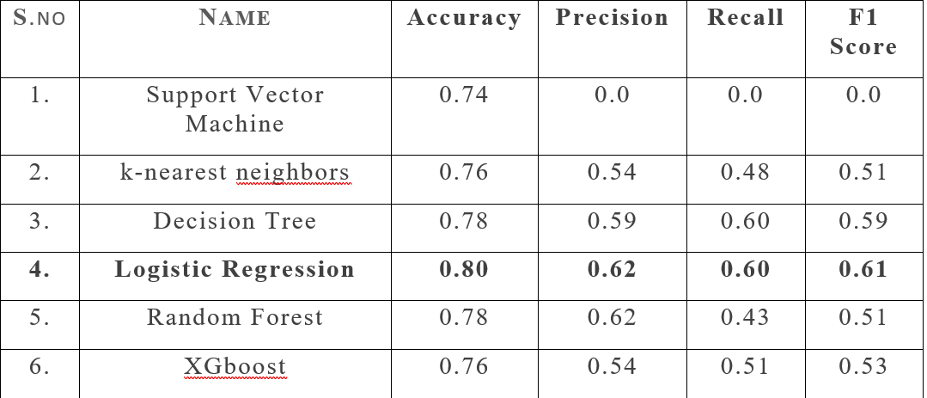
Model Building and Evaluation
The selected churn prediction model is trained using the training set.
Model performance is evaluated using various metrics like accuracy, precision, recall, AUC-ROC, to assess its effectiveness.
Performance of several models including decision trees, random forests, SVMs, KNN, XGboost etc. are compared with logistic regression.

Slide 15
Model Improvement
used two techniques to do this: ROC and AUC analysis and k-fold cross-validation.
adjusting the threshold value for predicting churn and re-evaluating the AUC score.
K-fold validation is performed several times on the data and calculated the auc score.
Auc score improved from 0.81 to 0.86.

Slide 16
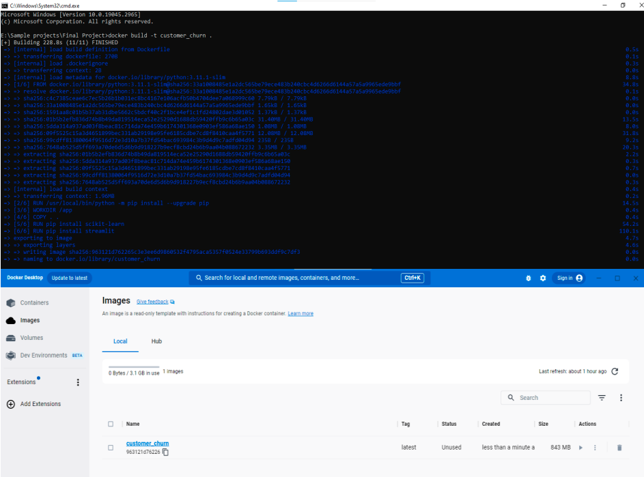
Deployment
For deploying our application Web app created using streamlit library of the Python.
After building model some important objects are extracted using pickle library for the deployment of the model.
After making the application using streamlit then the whole application is Containerized using docker.

Slide 17
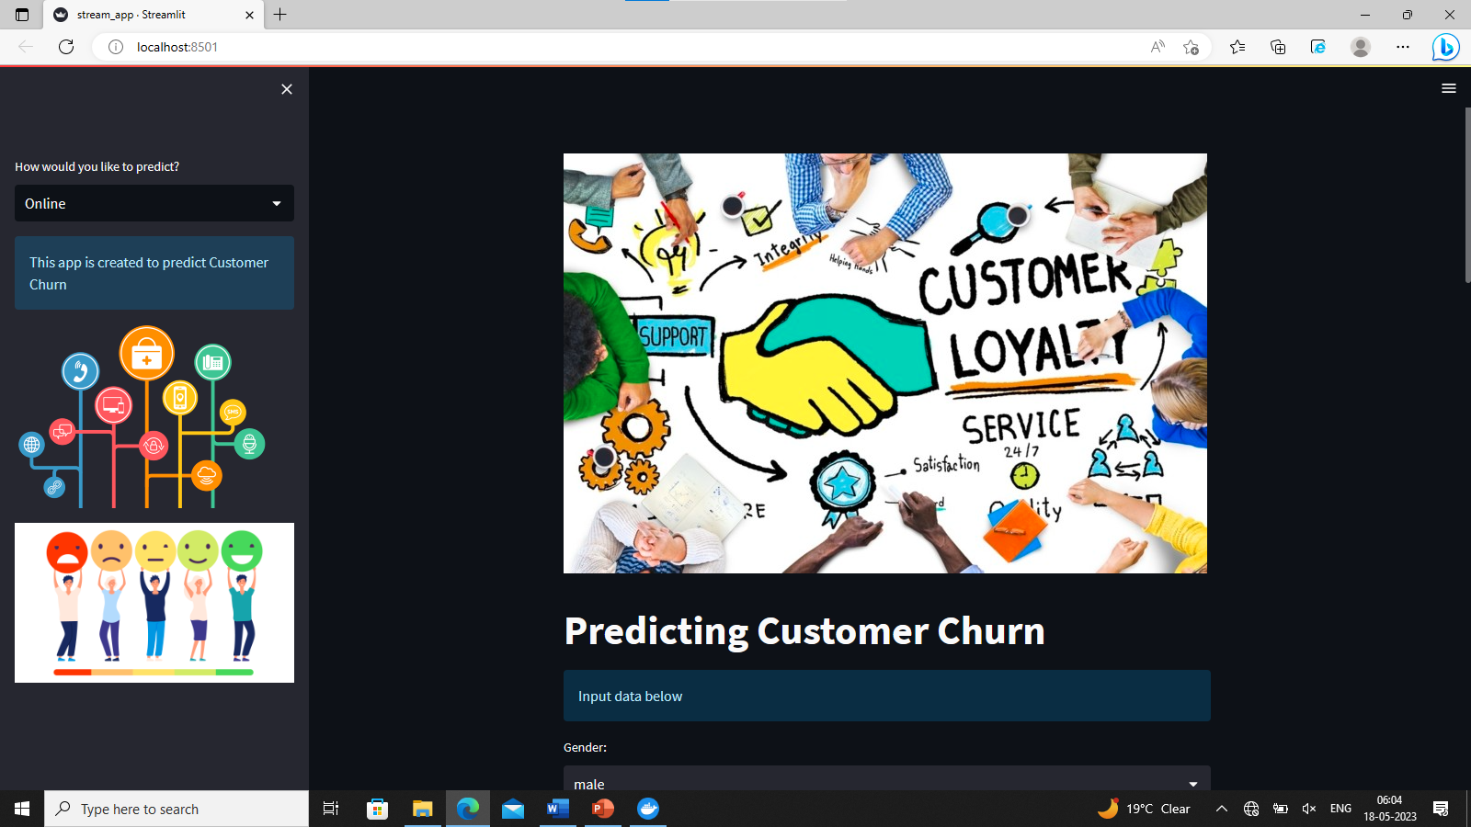
Front End of Application
In online Mode

Slide 18
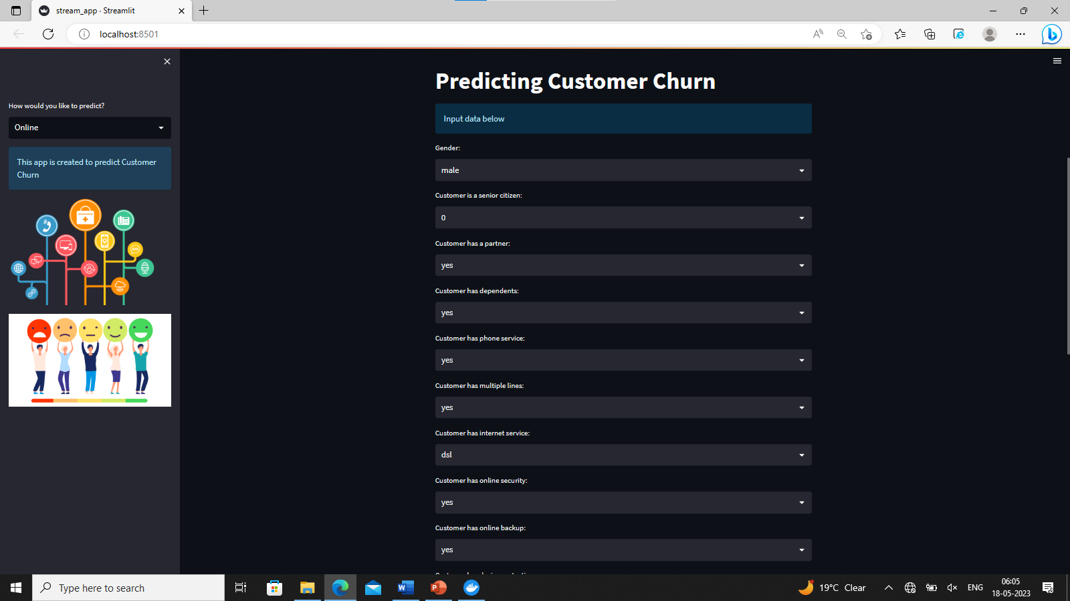
Front End/Final Output
Data to be Entered

Slide 19
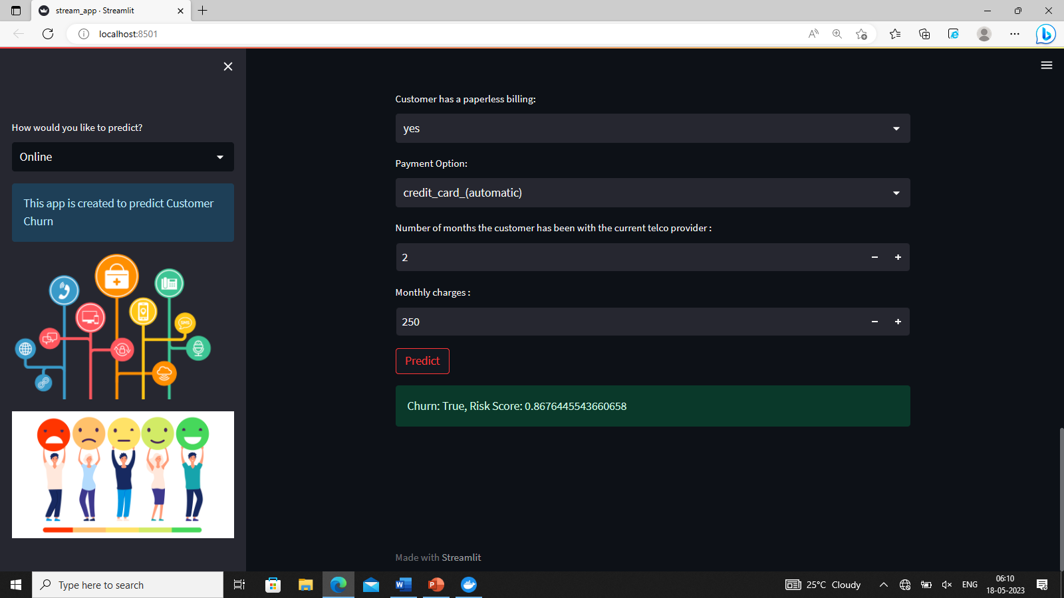
Final Output

Slide 20
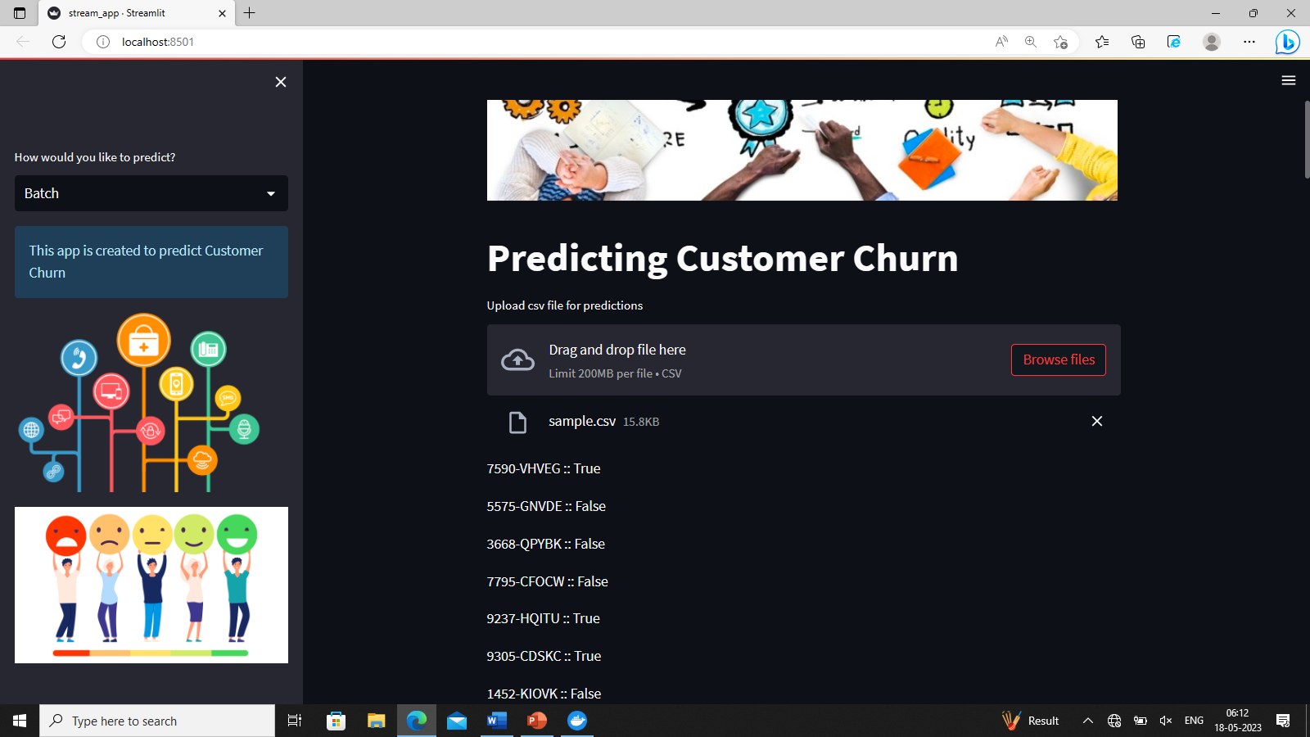
Final Output
In Batch mode

Slide 21
Thank You

